Slide 1
Human-Powered Vehicle Team
Midpoint Presentation
By: Yen C., Yujie Z., Abdulh A., Daniel Q., Connor T.

Slide 2
Project Description
Goal:
The team has been working on developing a regenerative propulsion system for the existing HPV. Our design is now a kinetic energy recovery system. We will retrofit the existing HPV that the customer has selected for us.
Sponsor:
Department of Mechanical Engineering
Client:
Dr. Perry
Budget:
$1500
Yujie Z. - Oct. 15, 2021 - HPVCP

Slide 3
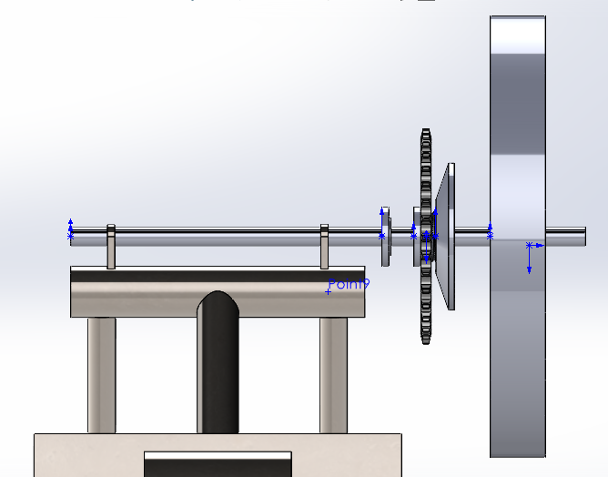
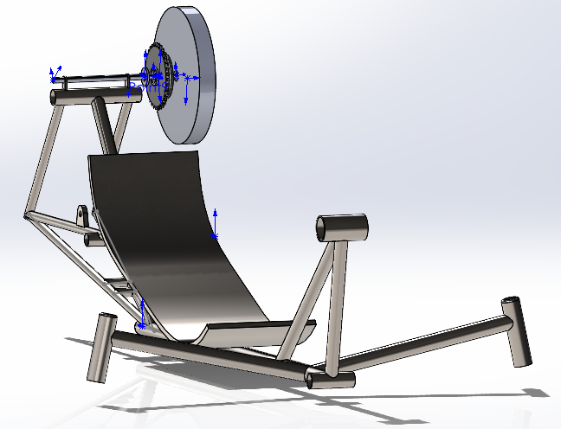
Design Description
Since the semester began, the system has undergone a complete redesign, and a new clutch system has been adapted.
The new system is not driven by the operator, but is simply an energy collection system (regenerative braking)
Clutch system is now driven on opposite side of the pedal drive, and is entirely separate
The flywheel has been redesigned in accordance to energy input by the vehicle, rather than a constant input from an operator
Daniel Q. - Oct. 15, 2021 - HPVCP

Slide 4
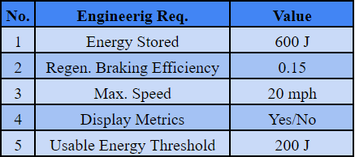
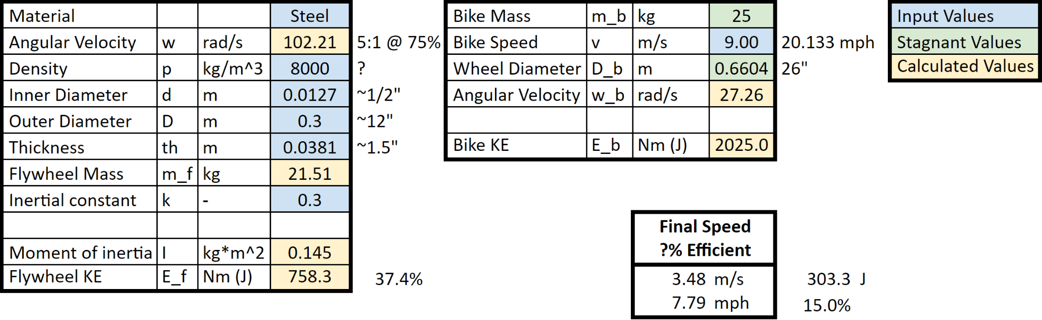
Current State of System
With all of our design finalized, we need to now move into the production phase.
The flywheel dimensions, as well as all hardware choice has been chosen in order to retrieve as much energy as possible when loading the flywheel, and to expend as much as possible when employing the stored energy.
Abdulh A., Connor T. - Oct. 15, 2021 - HPVCP

Slide 5
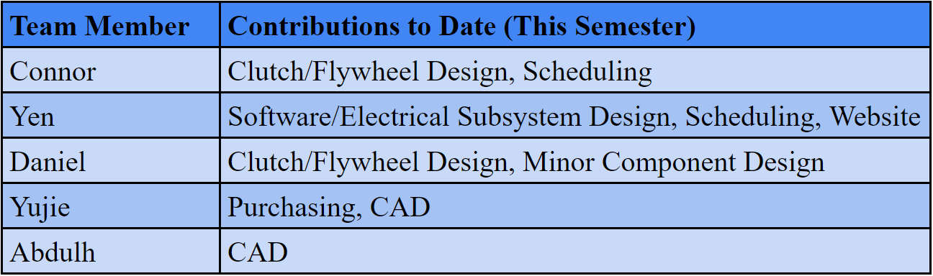
Current State of System
As we can see from the breakdown, the clutch design has been completed by Daniel and Connor. This task entailed adapting a clutch design to our new vehicle, meaning a complete rebuild, as described prior. Both have built analysis tools, as well as major design conceptualization.
To measure the systems inputs and outputs for testing, Yen has built a system for data collection, as will be described momentarily. Past that, Yen has also constructed the team’s website.
Yujie has taken care of all of our purchasing, along with the new frame design in cad, for placing our system.
Abdulh has helped primarily with CAD for parts we needed modeled quickly in order to continue building out the system.
Abdulh A. - Oct. 15, 2021 - HPVCP

Slide 6
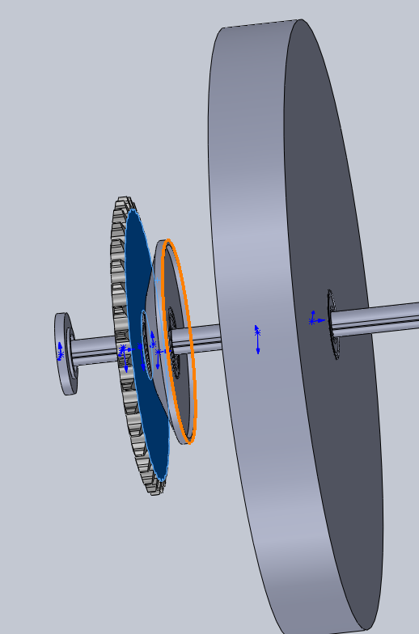
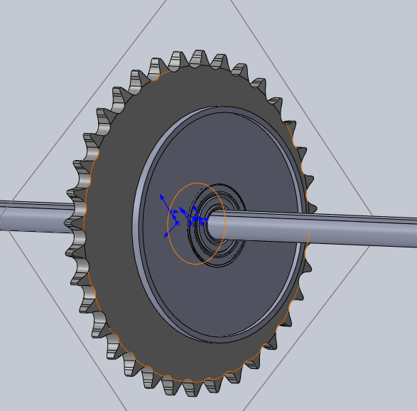
Current State of Design
Daniel Q. - Oct. 15, 2021 - HPVCP

Slide 7
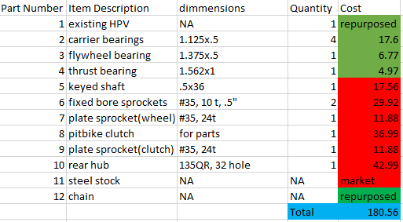
Bill of Materials
(Propulsion System)
Yujie Z. - Oct. 15, 2021 - HPVCP

Slide 8
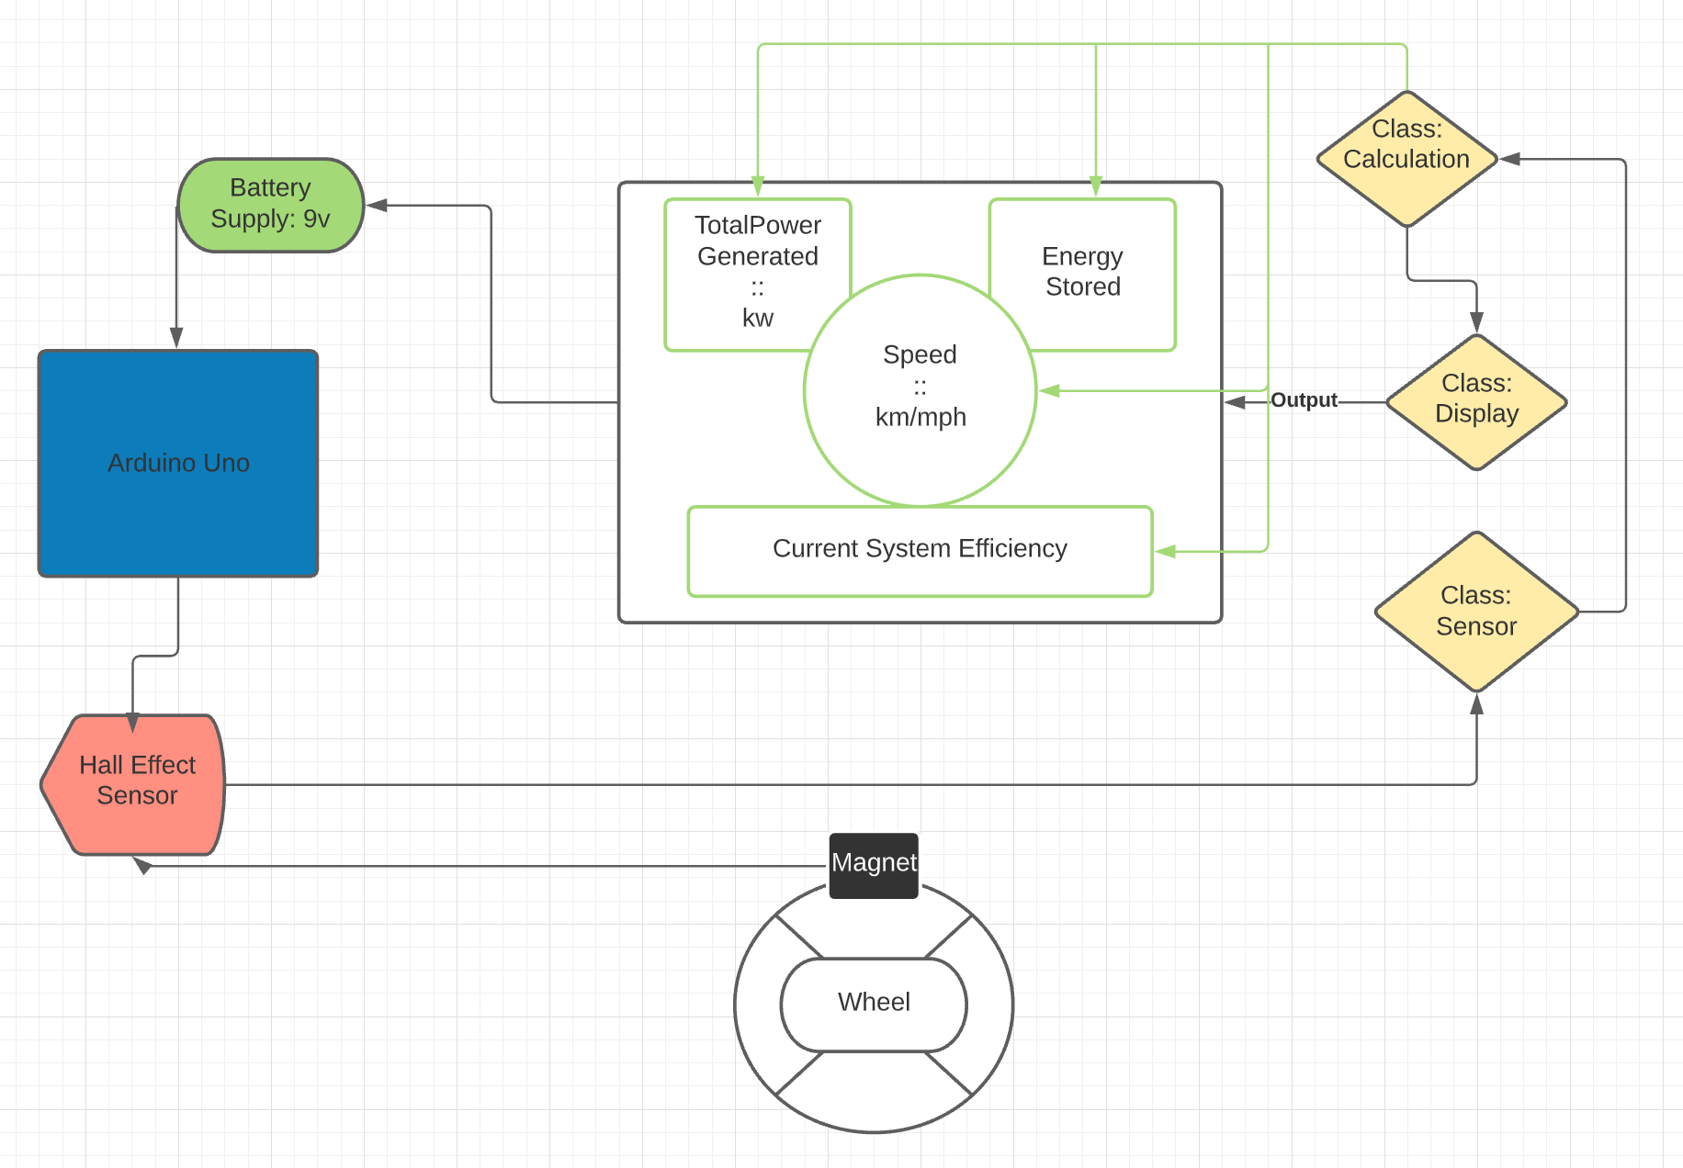
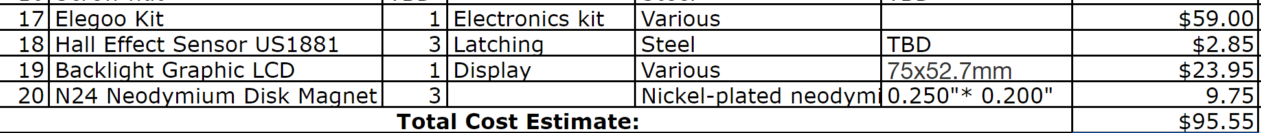
Current State of System
( Sensors & Display)
Software Completed: Modules, Functions, Variables, & Calculations have all been determined
Parts Acquired: Arduino Uno, Hall Effect Sensor, 9v Battery, various wires
Parts Awaiting: Display Piece, Neodymium Magnet
Yen C. - Oct. 15, 2021 - HPVCP

Slide 9
Implementation Plan
https://docs.google.com/spreadsheets/d/1zaRnv2IVfa7HDSeuy5Jv8aLe9uKDoJl3PUpaQFp_yt0/edit#gid=0
Daniel Q. - Oct. 15, 2021 - HPVCP

Slide 10
Testing - Software/Sensors
[ER 3,4,5]
Procedures
Software
  Unit Tests
    Display
    Sensor
    Calculations
      Use ‘Assert’
  System Testing
    Test cases involving expected input and output
    Use of Tachometer & Odometer
  End User Acceptance Testing
Tools Used
Tachometer (Thermal Fluids Lab)
Odometer
Python
Yen - Oct. 15, 2021 - HPVCP

Slide 11
Testing - Clutch Efficiency/Energy Storage
[ER 1,2]
Procedures
Measure vehicle speed
Engage clutch to power flywheel
Measure flywheel angular velocity
Measure vehicle speed
Engage clutch to remove power from flywheel
Measure vehicle speed
Repeat steps at different speeds
Tools Used
Sensors/Display
Tachometer/Odometer if necessary
Connor T. - Oct. 15, 2021 - HPVCP

Slide 12
Testing - Wear
Procedures
Measure clutch plate thickness before efficiency tests
Record the amount of times the clutch is engaged/for how long
Measure clutch plate thickness after efficiency tests
Tools Used
Calipers (Machine Shop)
Connor T. - Oct. 15, 2021 - HPVCP

Slide 13
Questions?

